Slide 1

Chapter 5 – part I

Slide 2
OUTLINE
  Applications of Newton’s laws.
  Apparent weight and weightlessness.
  Problems.

Slide 3
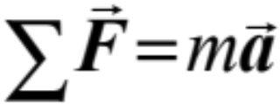
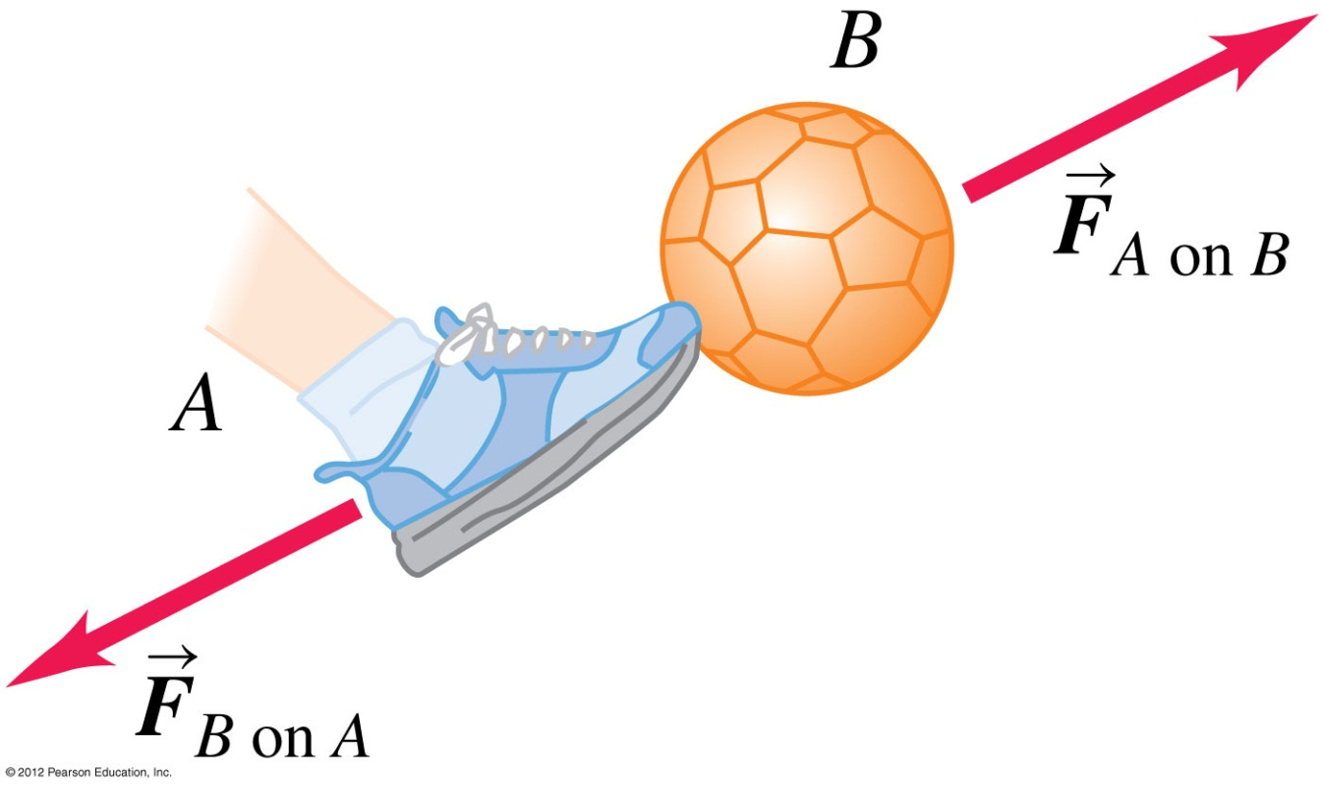
Newton’s laws of motion
First law of Newton: a body acted on by zero net force moves with constant velocity and zero acceleration.
  Second law of Newton: the acceleration of an object is directly proportional to the net force acting on it, and inversely proportional to the mass of the object.
  Third law of Newton: a force and its reaction force have the same magnitude but opposite directions (these forces act on different bodies).

Slide 4
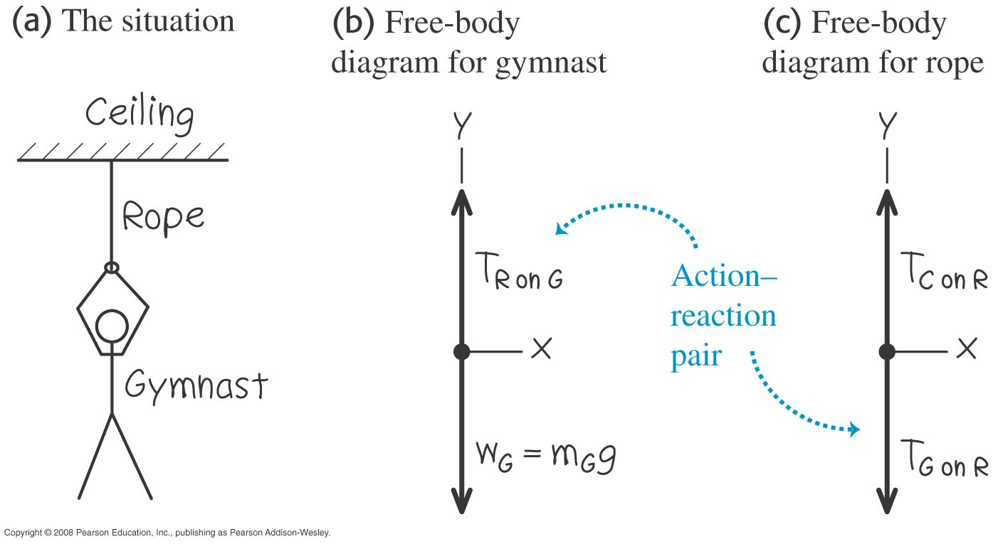
One-dimensional equilibrium: Tension in a massless rope
  A gymnast hangs from the end of a massless rope.

Slide 5
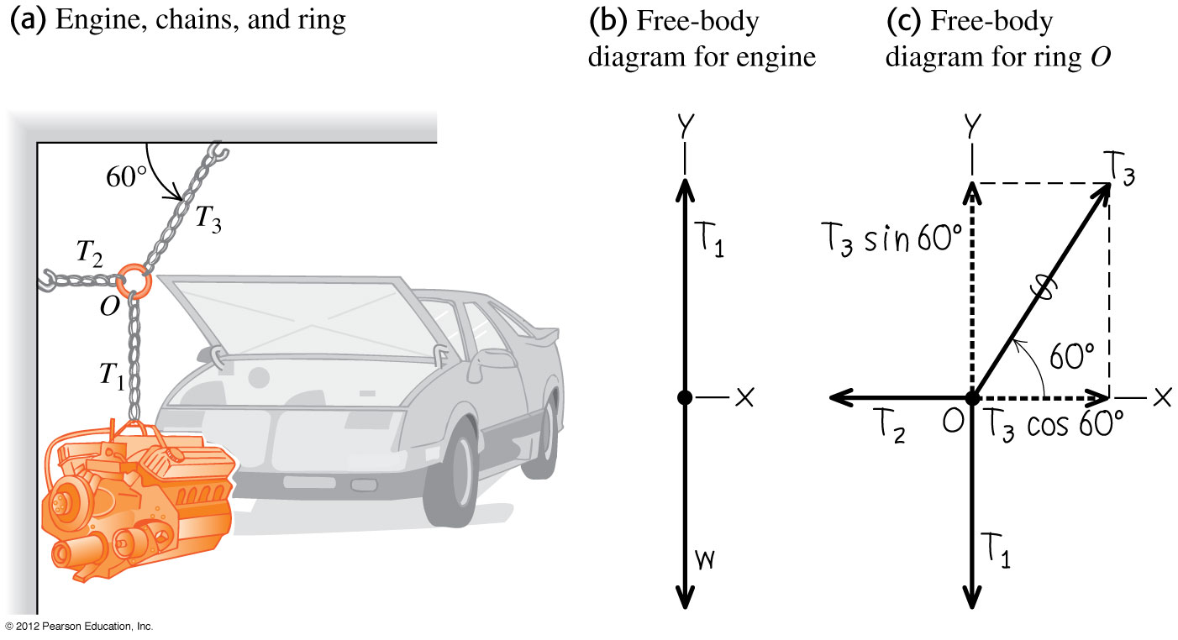
Two-dimensional equilibrium
A car engine hangs from several chains.

Slide 6
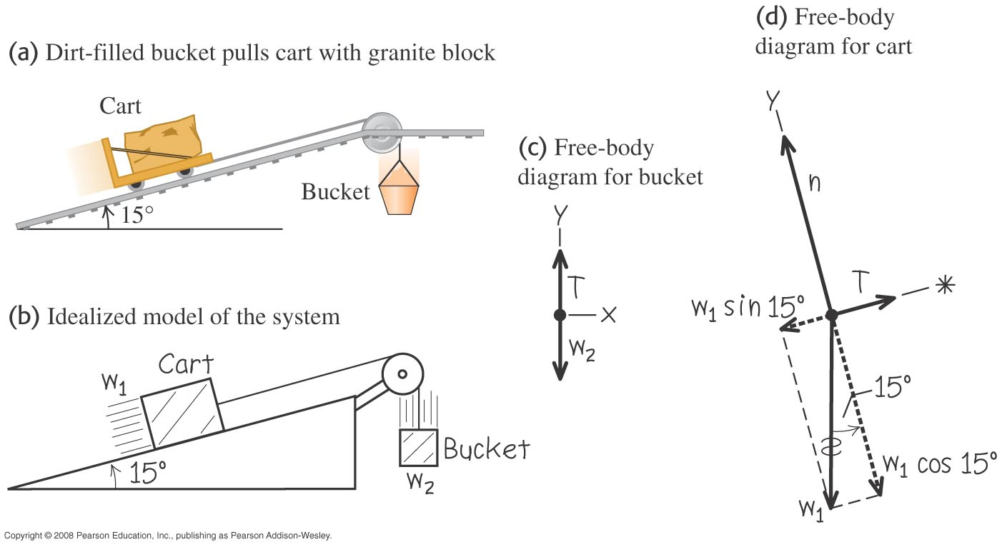
Bodies connected by a cable and pulley
A cart is connected to a bucket by a cable passing over a pulley.
Draw separate free-body diagrams for the bucket and the cart.

Slide 7
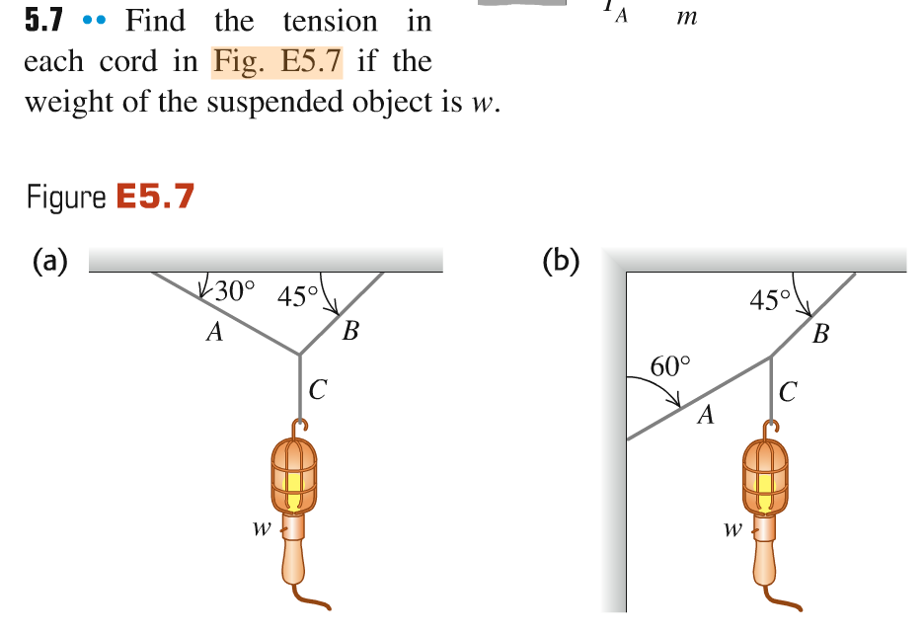
Problem #1
320 N

Slide 8

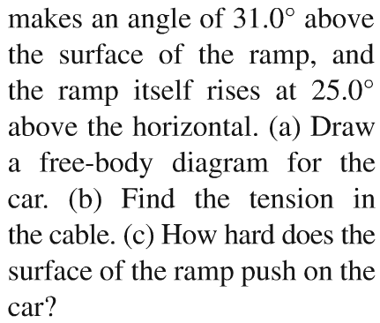
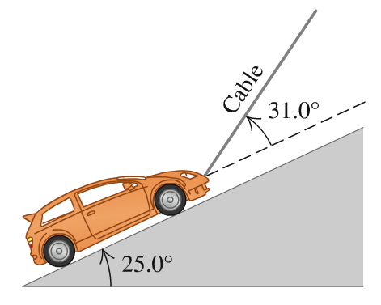
Problem #2

Slide 9
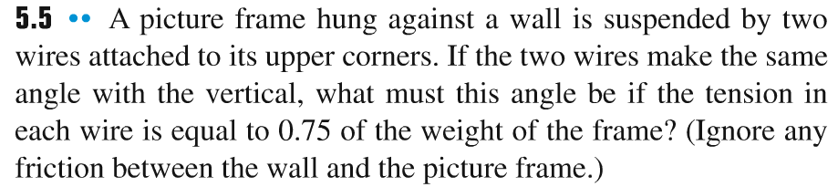
Problem #3

Slide 10
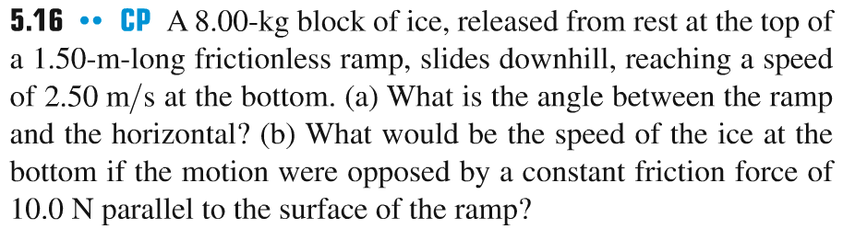
Problem #4

Slide 11
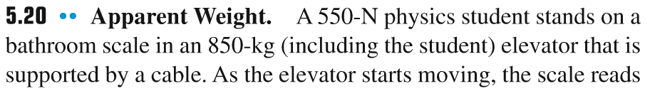
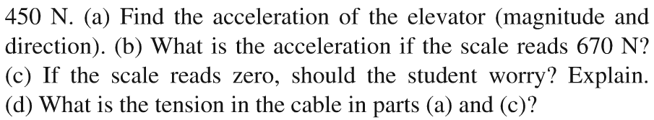
Problem #5

Slide 12
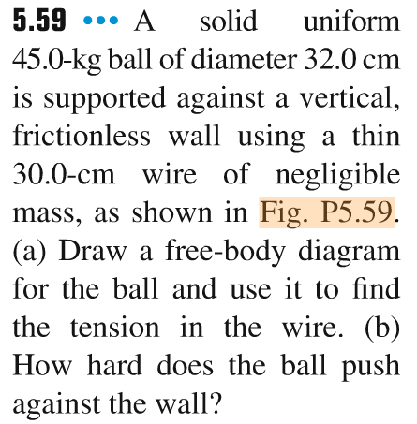
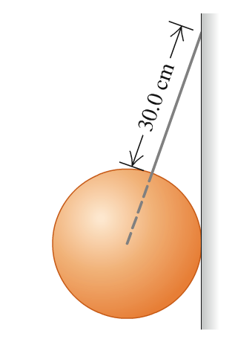
Problem #6

